Slide 1
BRAILLE TRANSLATOR
MEDASANI VINEETHA 19116041
NITIKA GUPTA 19116044
PALLAVI SINGH 19116045
TANYA RAMPAL 19116080

Slide 2
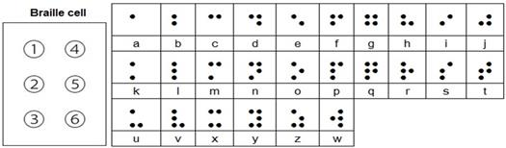
Braille Representation
Braille symbols are formed within units of space known as braille cells.
Each Braille character or "cell" is made up of 6 dot positions, shown in Figure below, arranged in a rectangle comprising 2 columns of 3 dots each .
A dot may be raised at any of the 6 positions, so, counting the space, in which no dot is raised, there are 64 such combinations in total (that is, 2 to the power of 6).
There is a 7 segment LED display as well which displays the ascii values of braille to text output.

Slide 3
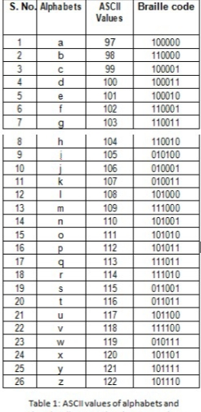
ARCHITECTURE OF THE DESIGN
To convert a given sentence with its braille equivalent binary digit and storing it in an output variable, which is connected to a keypad. This is done according to table no 1.
The output reg type vector will have 6 bits corresponding to each translated letter from the input
A storage element(latch) is formed to pass on these values through a buffer.
The latch allows the current 6 bit braille letter to be shown on the keypad, while the next letter in the sentence is being processed by the circuit.
The translation is done with the help of ‘case’ statement in Verilog .

Slide 4
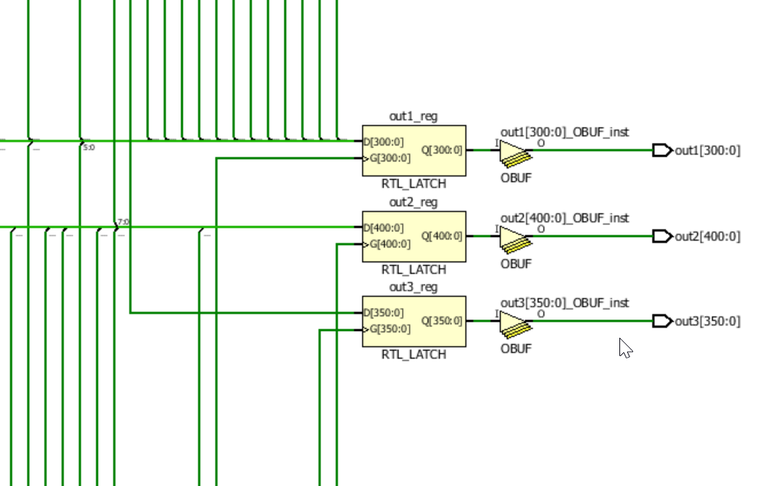
The case statement is mapped into multiple multiplexers as shown in the Synthesis design diagram.
The given keypad consists of pins numbered 1-6. Each pin depicts a button that will pop up when it's high(its value is 1) and remain at surface level when it's low(it's value is 0)
This enables the visually able person to understand the translated text.
Similarly, when the person enters Braille code, it is translated back into a sentence using the case statement and output reg vector(out2) which also forms a latch.
Then out2 is converted into 7 bit led form, though case statement which is stored in out3.

Slide 5
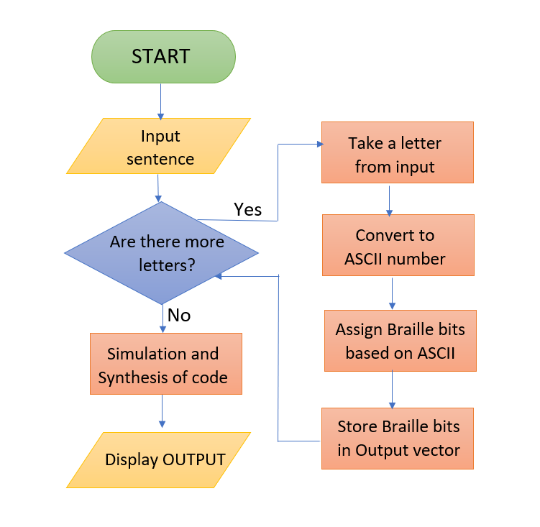
FLOW CHART
Text-to-Braille
Sentence to be converted to braille is entered by the user.
Each letter is processed one by one.
Each letter is taken is converted to its corresponding 8-bit ASCII number.
Letter in its ASCII form is then associated with its 6-bit BRAILLE equivalent binary code.
Braille code is stored in an output vector that is connected to the keypad.
The above steps are repeated unless all the letters in the sentence are processed.
Code is then simulated to check the functional correctness of our verilog code.
Synthesis tool produces the gate-level verilog description.
Output is then displayed on the keypad.

Slide 6
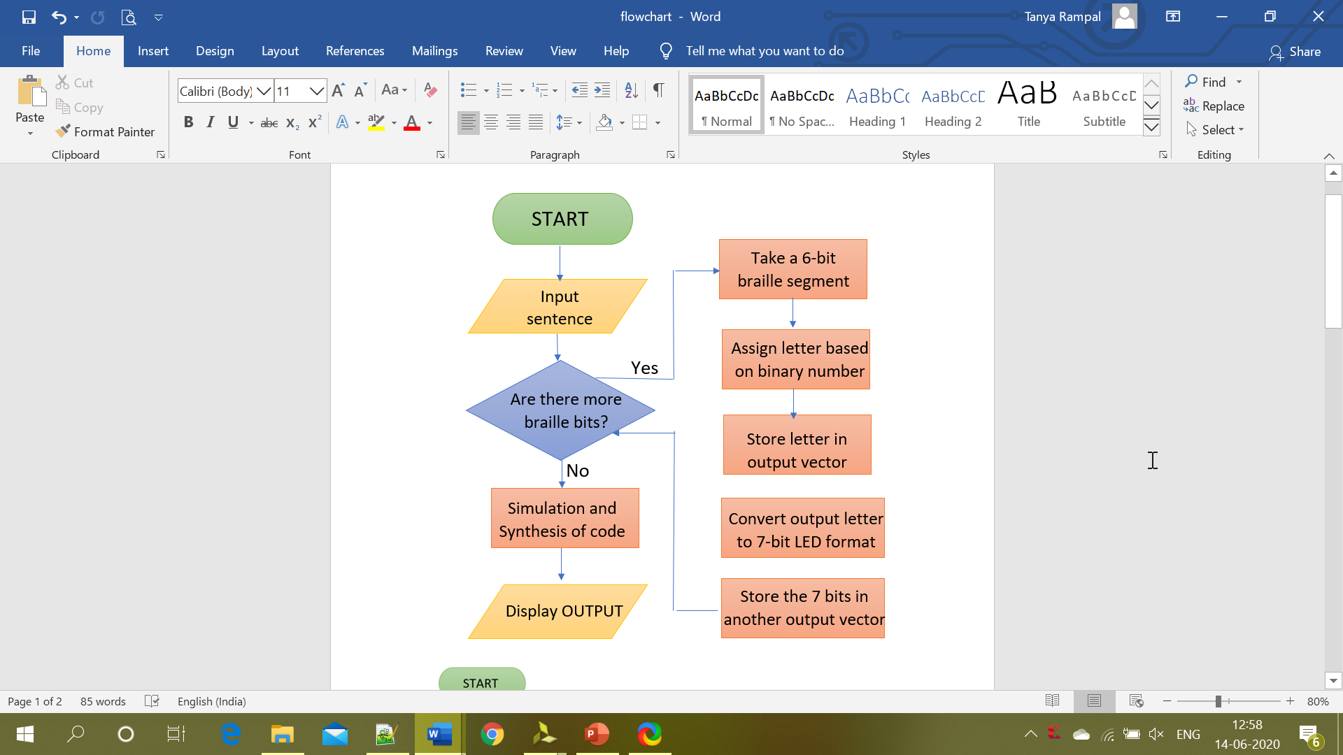
Braille-to-text
Braille code to be converted to a sentence is entered by the user.
Each 6-bit segment is processed one by one.
Each segment is taken and is converted to its corresponding letter using case statement.
Braille code is stored in an output vector(out2) that is connected to a screen.
Then all the letters of out2 are converted to 7 bit led segments ad stored in out3.
The above steps are repeated unless all the letters in the sentence are processed.
Code is then simulated to check the functional correctness of our verilog code.
Synthesis tool produces the gate-level verilog description.
Output is then displayed on the screen.

Slide 7
MAJOR CHALLENGES FACED
Lack of hardware to implement our project and see physical output.
Since ports cannot be unpacked arrays, vectors were used to store input/output results, which can cause storage problems for very long words.
Correct output was not obtained until after several tries.
Simulation and synthesis results were sketchy at first and were showing errors.
There was lack of communication between team members due to lockdown.
Global pandemic created distractions and interference in our work.

Slide 8
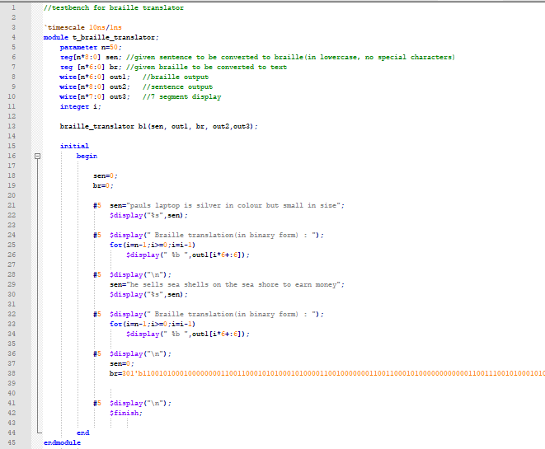
SIMULATION RESULTS
Simulation is used to verify the functional correctness of a digital design that is modelled using a HDL (hardware description language) like Verilog.
The test bench is used to simulate our design by specifying the inputs into the system.
Fig.1 shows the test bench of our braille translator Verilog code
Fig.1 Test Bench
Fig. 1 (Testbench)

Slide 9
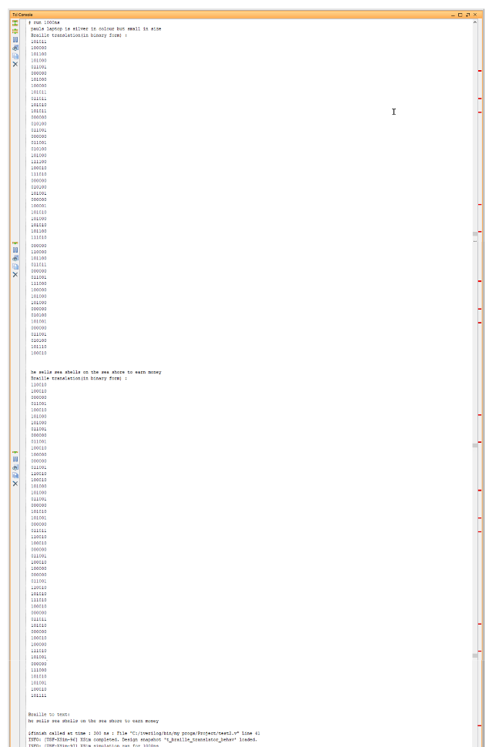
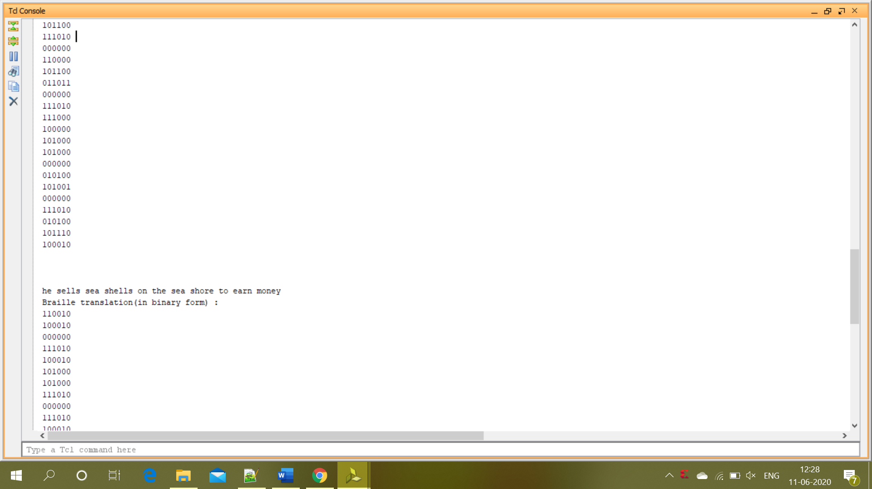
Simulation Output
Text-to-Braille
The output shows 6-bit braille code corresponding to each translated letter in the input sentence.
6-bit braille code corresponding to letter ‘e’ from ‘sells’
Text-to-braille output

Slide 10
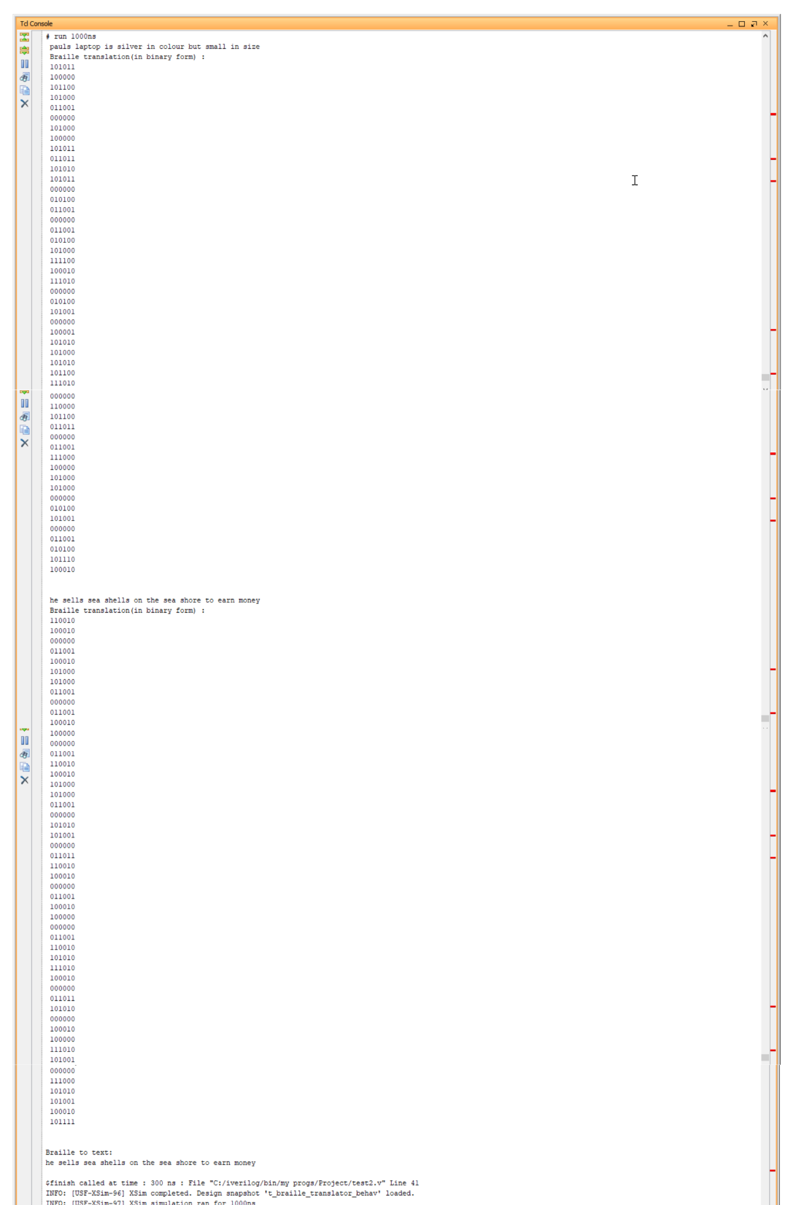
Braille-to-text
The output shows the text (in lower-case) corresponding to the input braille code.
Text produced corresponding to the input braille code
Braille-to-text output

Slide 11
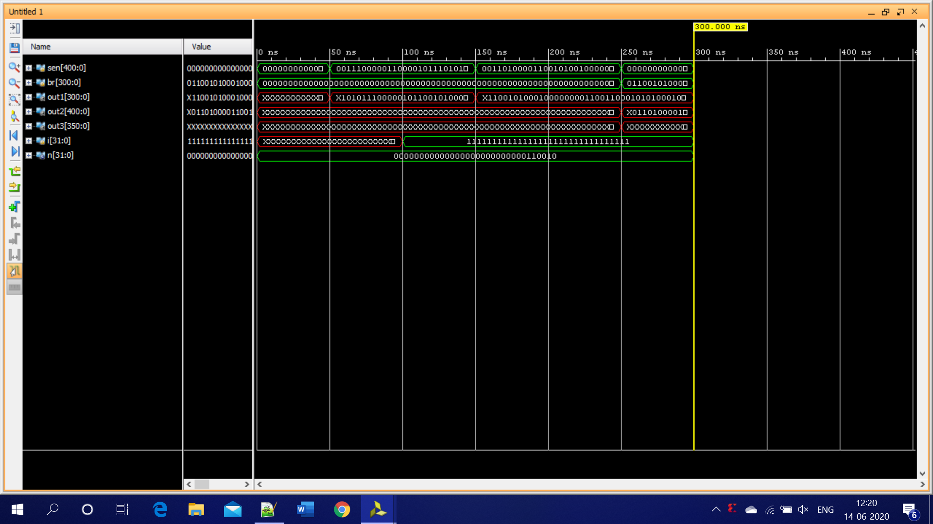
Simulation Waveform
Simulation allows us to view the timing diagram of related signals to understand how the design description in Verilog actually behaves.
The waveform below shows the progress of each signal with respect to time.

Slide 12
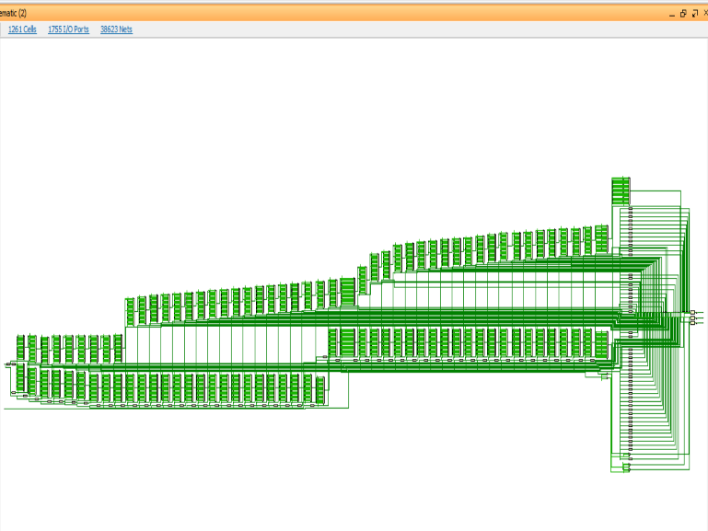
RTL Schematic
RTL (Register Transfer Level) schematic is generated after the HDL synthesis phase of the synthesis process.
Fig.2 shows the RTL schematic diagram which shows two latches .
The first latch is generated to pass the 6-bit values corresponding to each translated letter in the input sentence through a buffer.
The second latch is generated to pass 8-bit values(ASCII codes of text letters) corresponding to each 6-bit Braille code in the input through a buffer.
Fig.2 RTL Schematic diagram
RTL_latch(text to braille)
RTL_latch(braille to text)
RTL_latch(7 bit LED value)
Fig,2 (RTL Schematic)

Slide 13
SUMMARY
The design and implementation of text to BRAILLE translator has been presented in this project.
The aim of this translator is to help people who are blind and partially able to read and write. The ability to read and write in braille has opened door to literacy, equal opportunity and personal security.
A Text-to-braille translator has been successfully designed which converts a given sentence into braille code format consisting of cells of raised dot pattern.
Similarly a braille-to-text translator has been designed which convert a braille code to a sentence.
The VERILOG code has been successfully simulated using Xilinx VIVADO development platform.
The Architecture of the System tells us about how to convert a given sentence (which is in lowercase) into BRAILLE format and vice versa. and has a fixed number

Slide 14
There are various challenges during implementation such as Lack of Hardware, Synthesis and Simulation results were sketchy, etc.
Simulation results verify the correctness of digital design using VERILOG.
Test bench is used to simulate the design by specifying the inputs and Simulation Waveform shows the progress of each signal with respect to time (in ns).
Synthesizer performs architectural optimizations and the output is gate-level VERILOG description.
RTL Schematic describes how data is transformed as it is passed from register to register by the combinational logic that exists between the registers.
A latch is generated to pass the 6-bit values corresponding to each translated letter in the input sentence through a buffer.
The results obtained show that the system is able to implement text-to-Braille and Braille-to-text translation with high accuracy.

Slide 15
THANK YOU

